Slide 1
First, a word about rules…
Yes, we have rules. ☺
Do not pick someone else’s locks.
Do not pick your locks… if you rely on them.

Slide 2
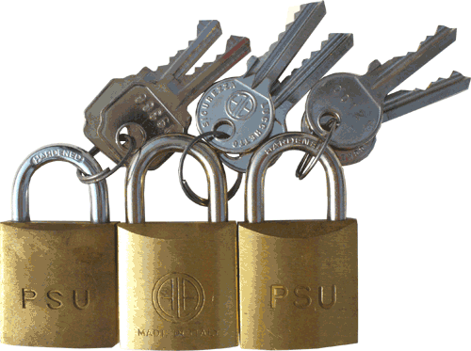
The Three Kinds of Lock-Opening

Slide 3
The Three Kinds of Lock-Opening
Lockpicking – what we do TOOOL provides the knowledge and the means – what spies do TOOOL provides neither knowledge nor means

Slide 4
The Three Kinds of Lock-Opening
Lockpicking – what we do TOOOL provides the knowledge and the means
Quick & Dirty– what spies do TOOOL provides neither knowledge nor means

Slide 5
The Three Kinds of Lock-Opening
Lockpicking – what we do TOOOL provides the knowledge and the means
Quick & Dirty – what criminals do TOOOL provides knowledge. . . but no means
Covert & High-Tech – what spies do TOOOL provides neither knowledge nor means

Slide 6
The Three Kinds of Lock-Opening
Lockpicking – what we do TOOOL provides the knowledge and the means
Quick & Dirty – what criminals do TOOOL provides knowledge. . . but no means
Covert & High-Tech – what spies do TOOOL provides neither knowledge nor means

Slide 7
The Three Kinds of Lock-Opening
Lockpicking – what we do TOOOL provides the knowledge and the means
Quick & Dirty – what criminals do TOOOL provides knowledge. . . but no means
Covert & High-Tech – what spies do TOOOL provides neither knowledge nor means

Slide 8
The Three Kinds of Lock-Opening
Lockpicking – what we do TOOOL provides the knowledge and the means
Quick & Dirty – what criminals do TOOOL provides knowledge. . . but no means
Covert & High-Tech – what spies do TOOOL provides neither knowledge nor means

Slide 9
The Three Kinds of Lock-Opening
Lockpicking – what we do TOOOL provides the knowledge and the means
Quick & Dirty – what criminals do TOOOL provides knowledge. . . but no means
Covert & High-Tech – what spies do TOOOL provides neither knowledge nor means

Slide 10
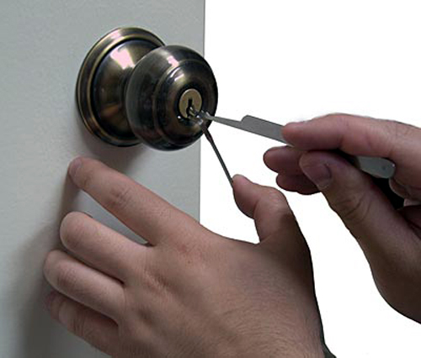
Lockpicking is Easy !

Slide 11
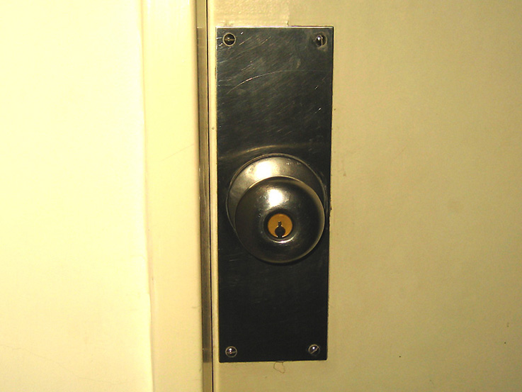
Doorknobs…

Slide 12
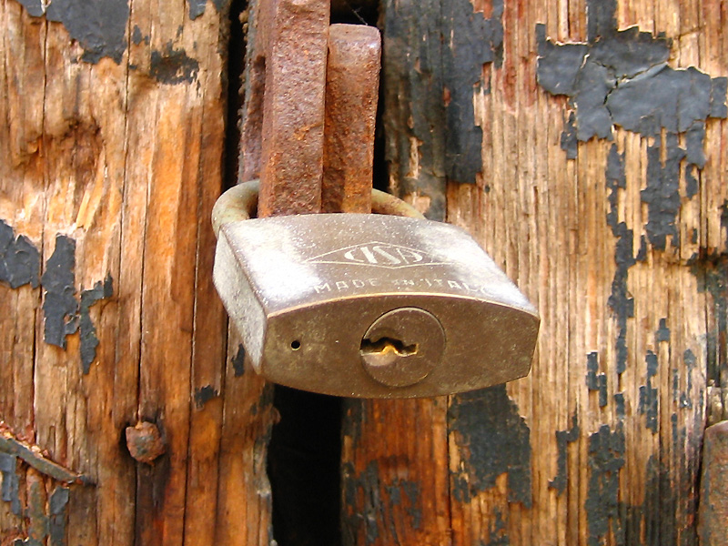
Padlocks…

Slide 13
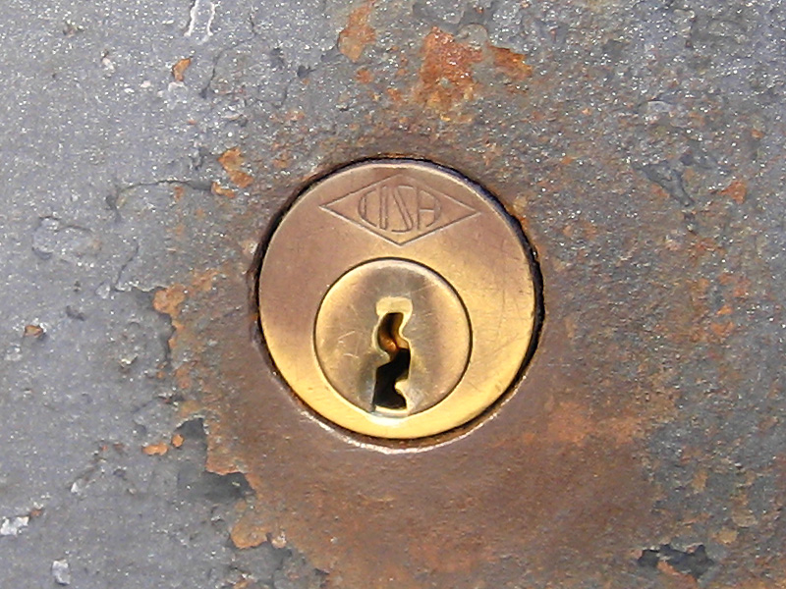
Deadbolts…

Slide 14
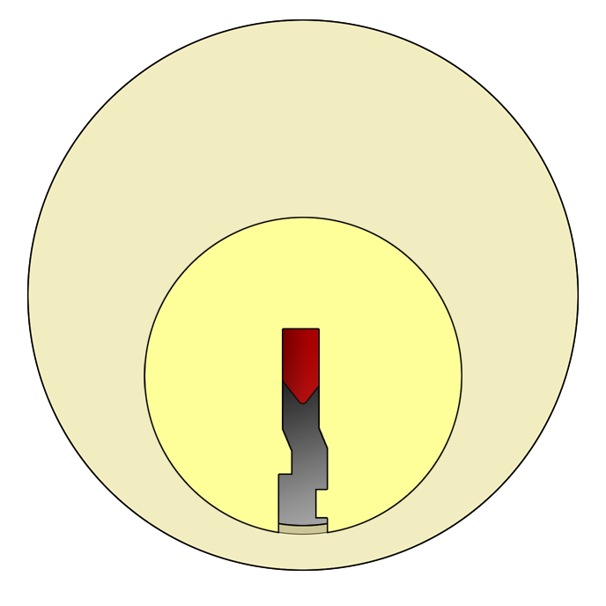
…The Mechanism Itself Is All The Same

Slide 15
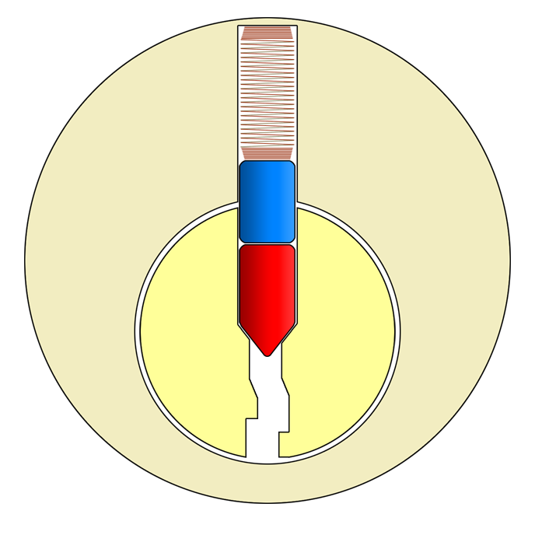
How It Looks Inside

Slide 16
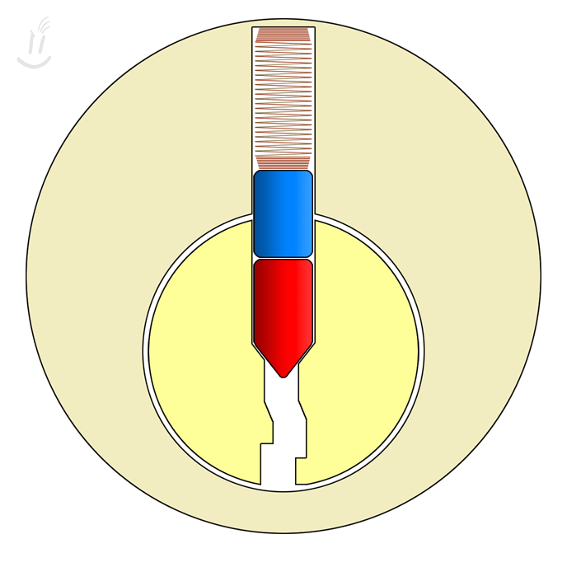
Attempt Without a Key

Slide 17
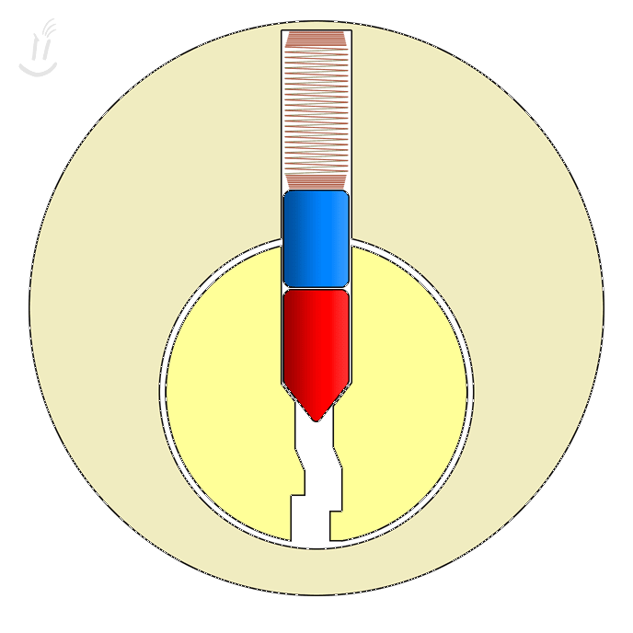
Operating With a Key

Slide 18
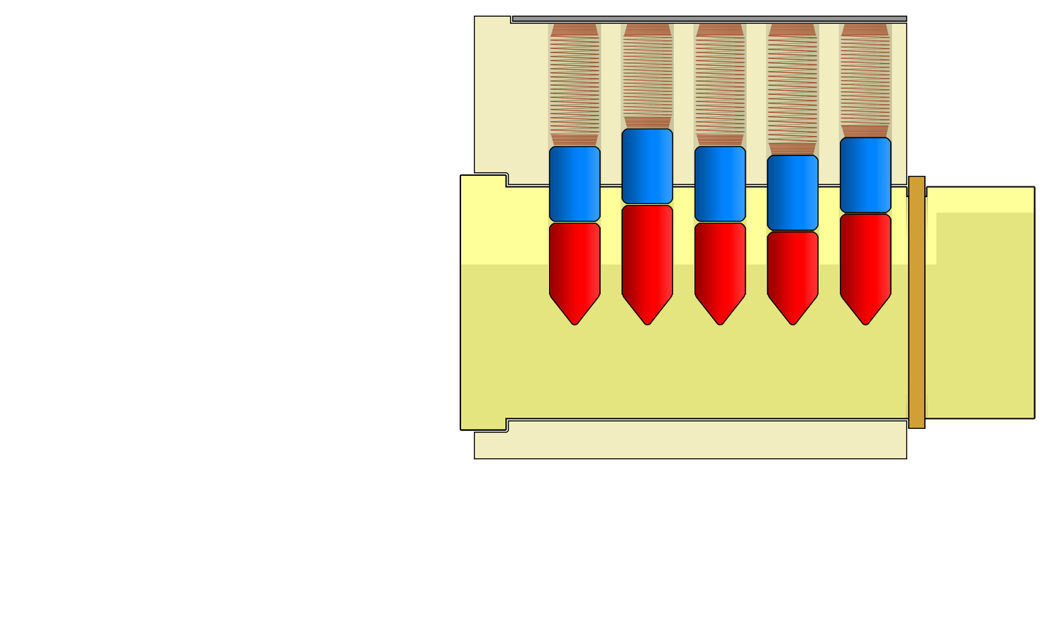
Pin Stacks

Slide 19
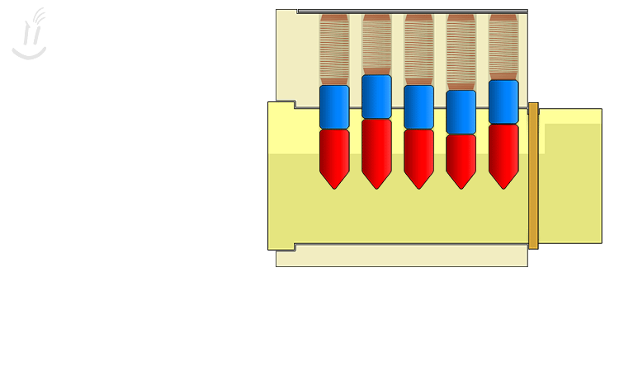
Using a Key

Slide 20
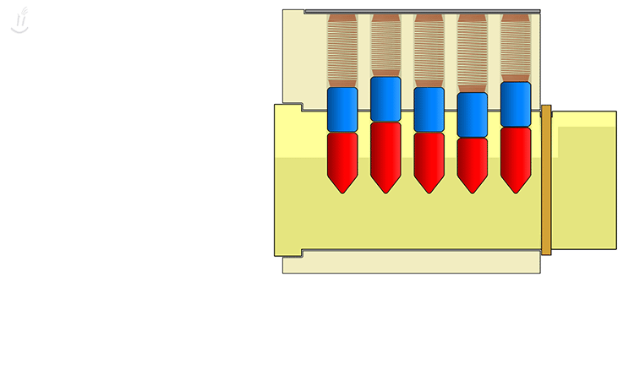
Using Lockpicks

Slide 21
So, Why Is Lockpicking Possible?

Slide 22
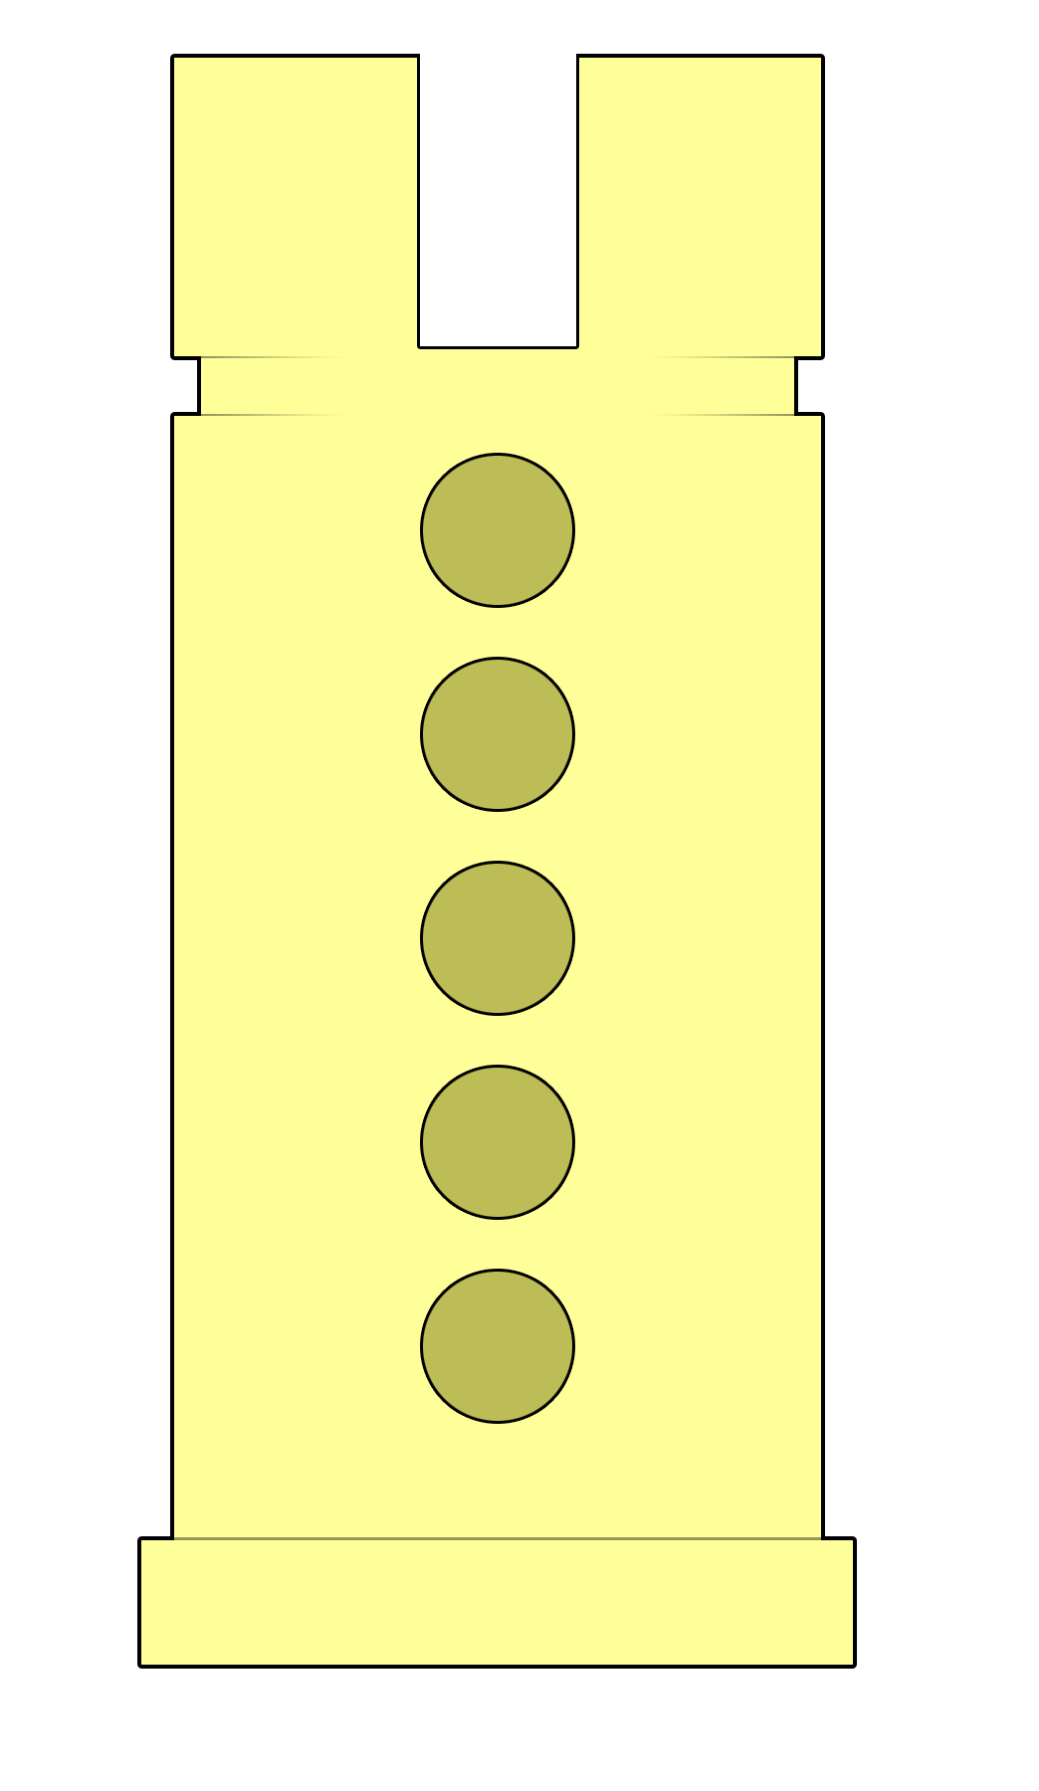
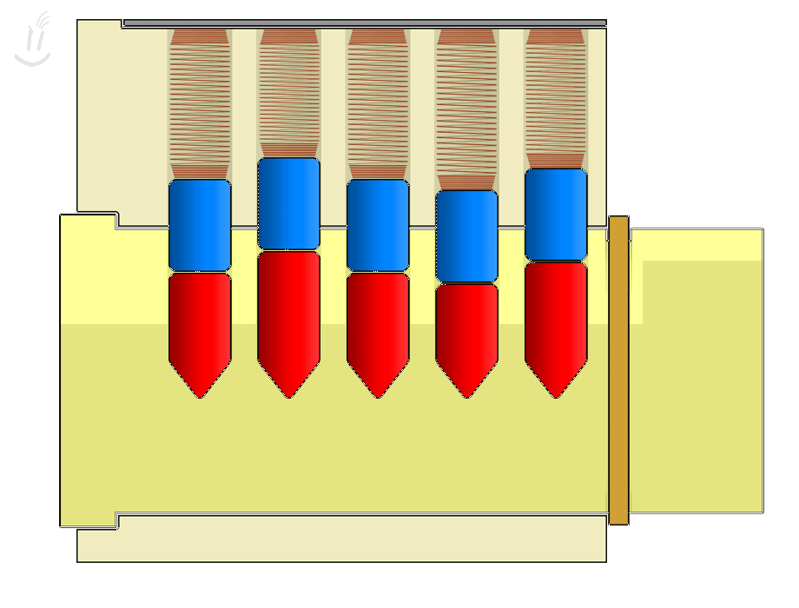
In a Perfect World The Parts Would Function Like This…

Slide 23
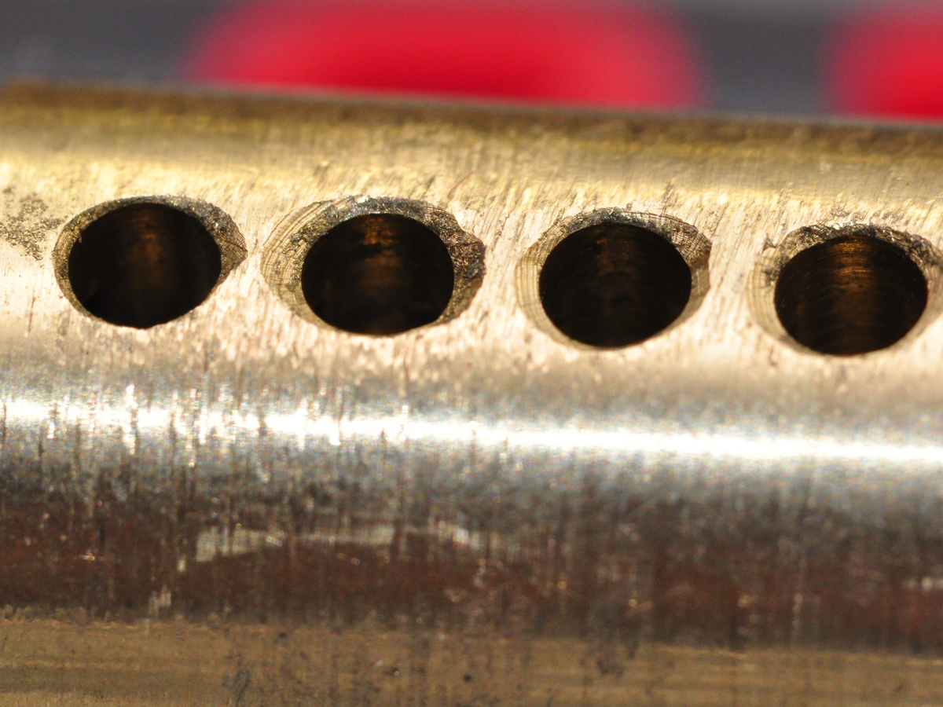
Parts In the Real World Look Like This…

Slide 24
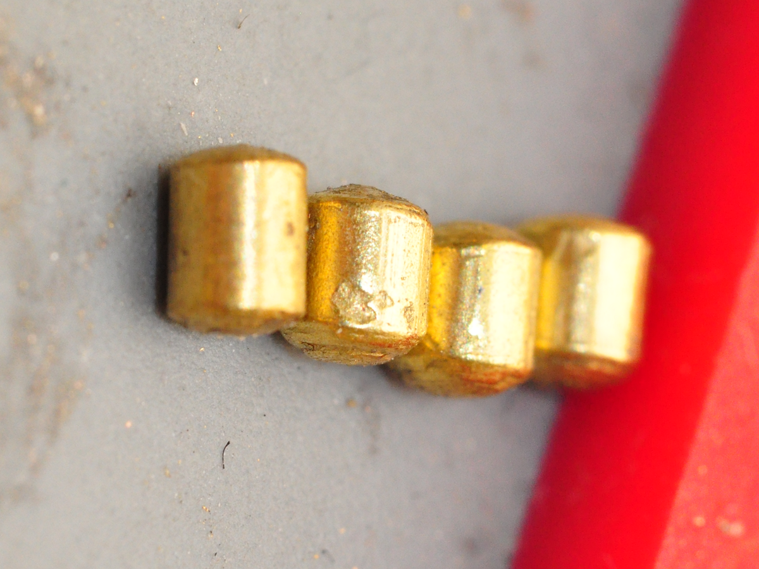
Parts In the Real World Look Like This…

Slide 25
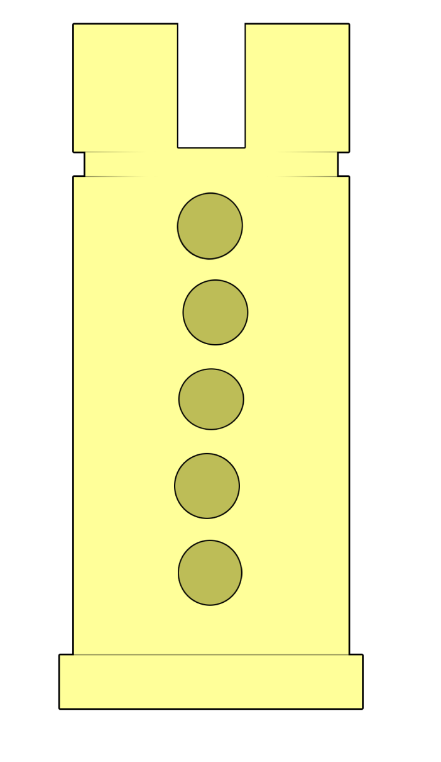

Parts In the Real World Function Like This…

Slide 26
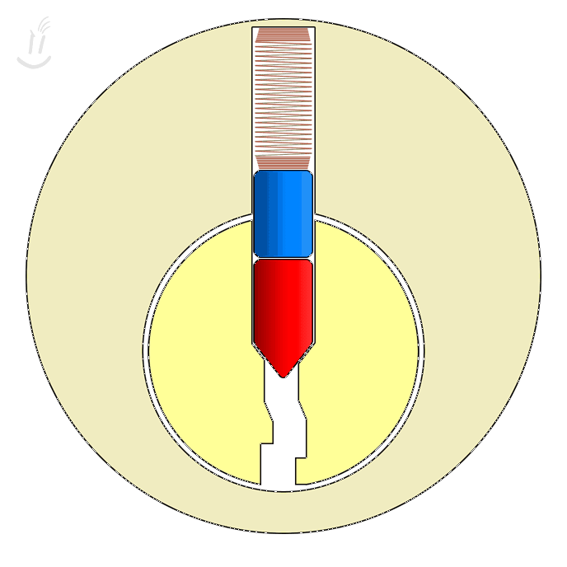
“Setting” a Binding Pin by Turning & Lifting the Stack

Slide 27
Setting Multiple Pins

Slide 28
Take Caution to Avoid Over-Lifting

Slide 29
Other Tools One Uses

Slide 30
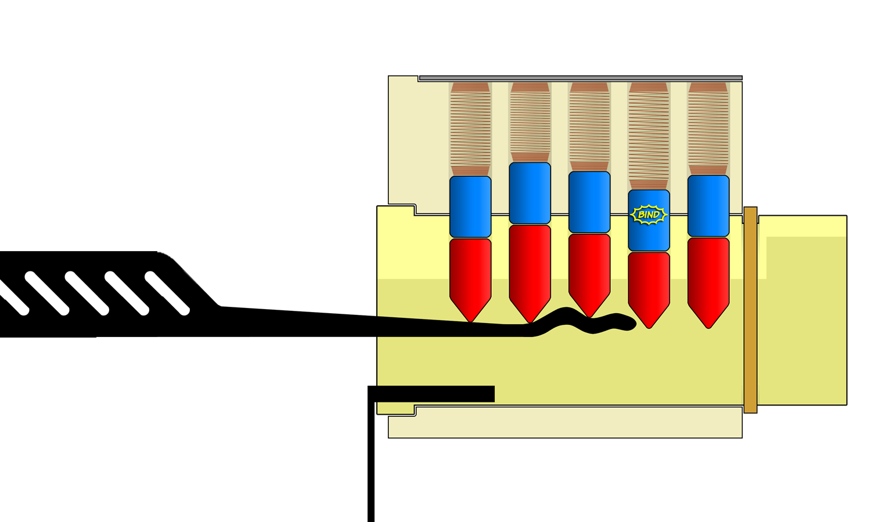
Raking Tools

Slide 31
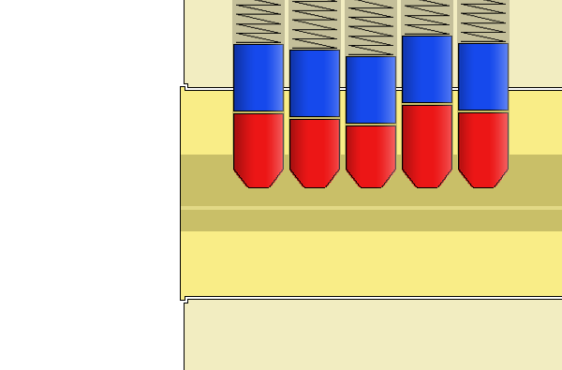
Raking Tools

Slide 32
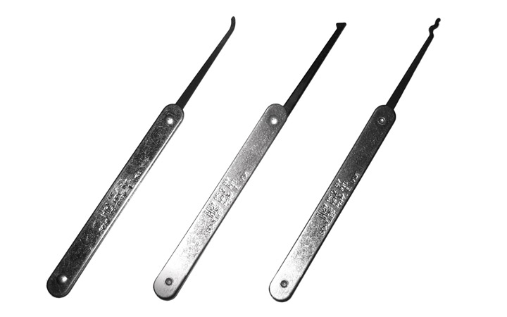
The Half-Diamond

Slide 33
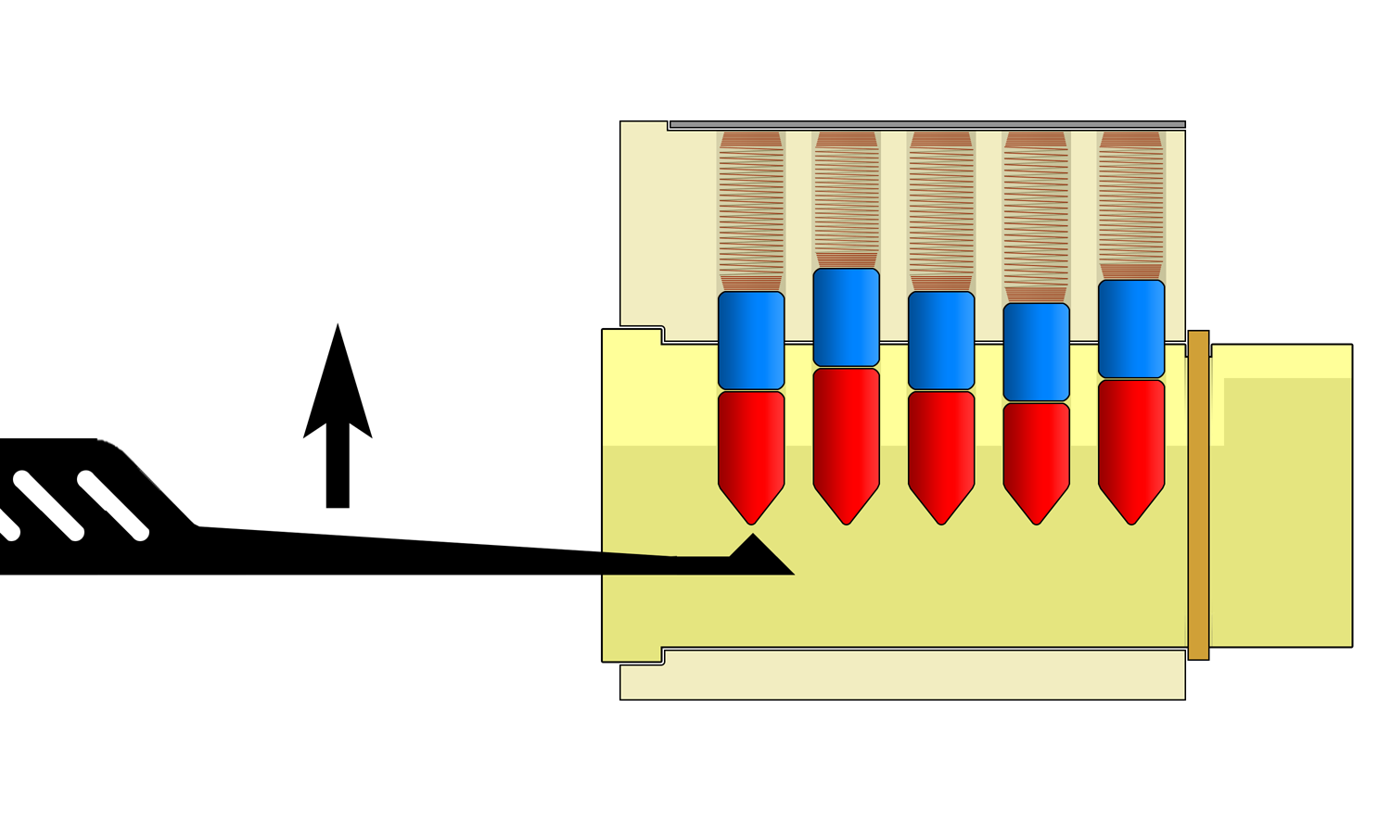
Lifting with a Half-Diamond

Slide 34
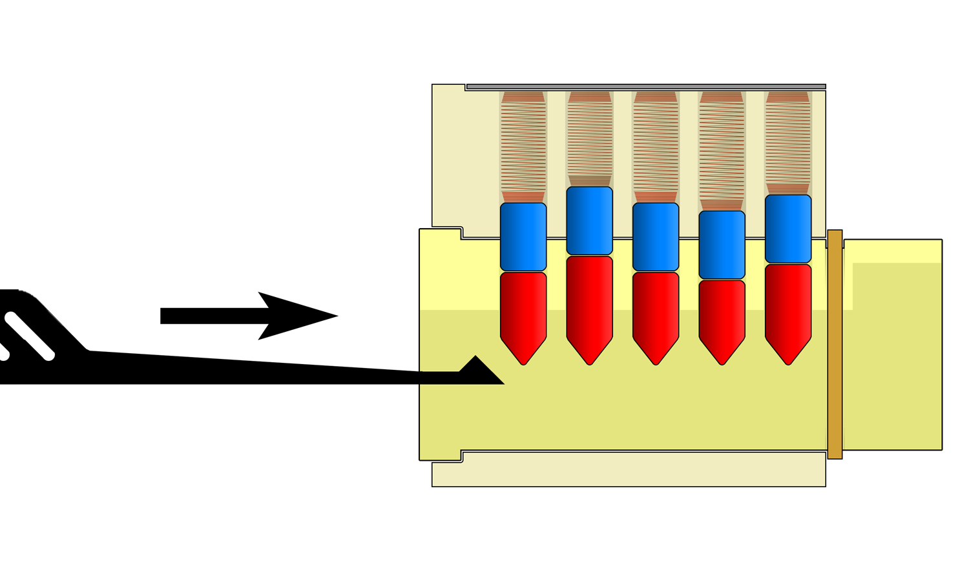
Raking / Shoveling with a Half-Diamond

Slide 35
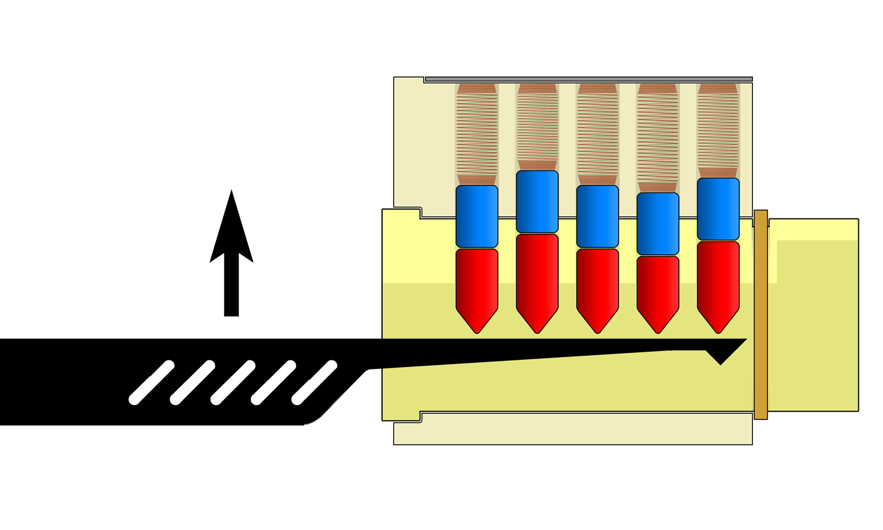
Using the Flat Underside

Slide 36
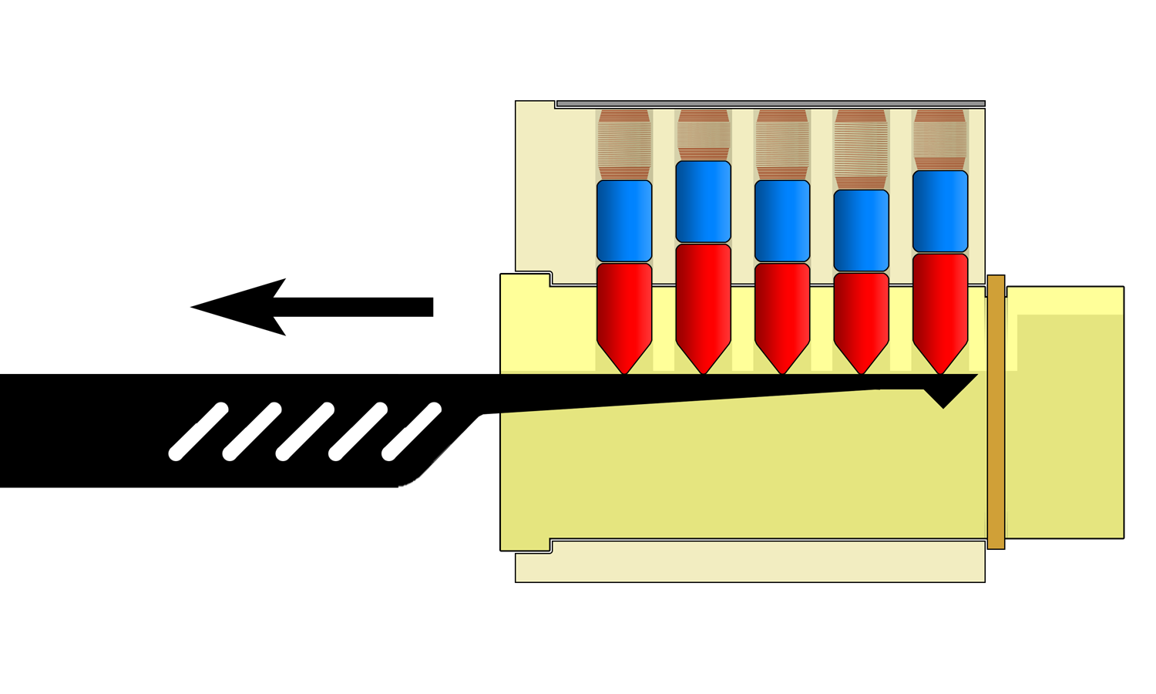
Counting Pin Stacks

Slide 37
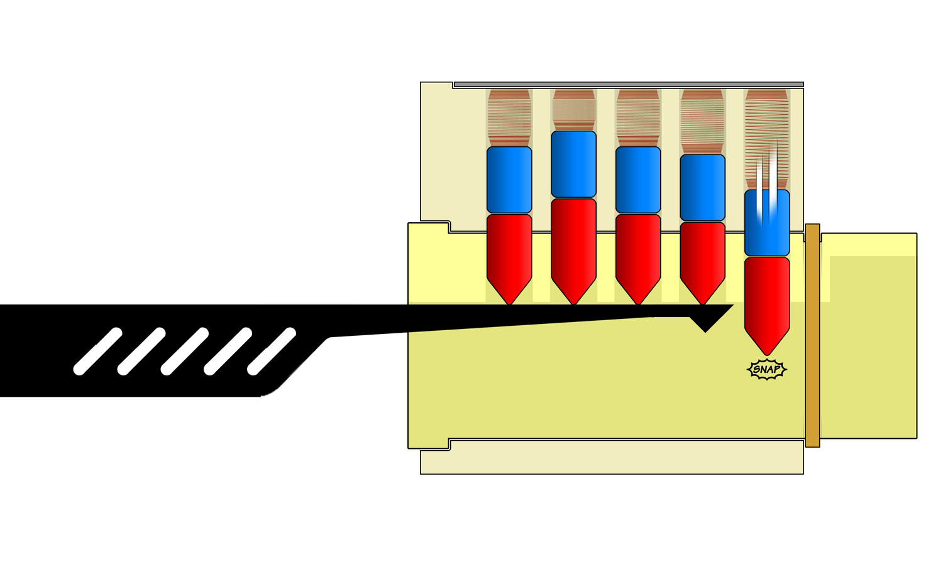
Counting Pin Stacks

Slide 38
Turning the Plug

Slide 39
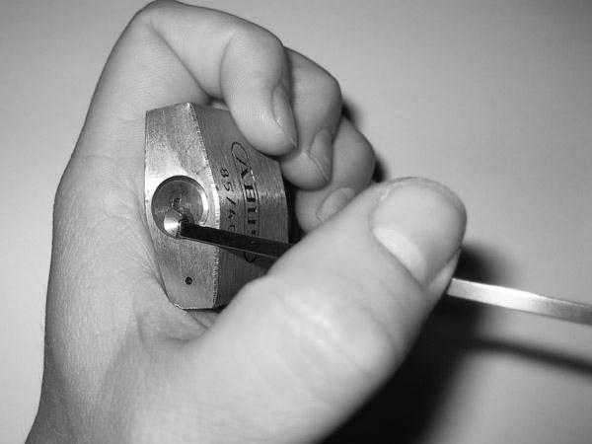
Bad Turning Tool Usage (Pulling)

Slide 40
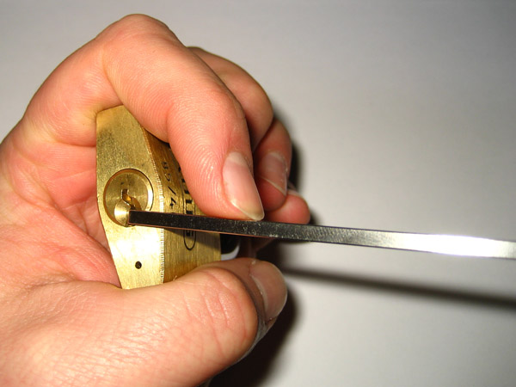
Better Turning Tool Usage (Pushing)

Slide 41
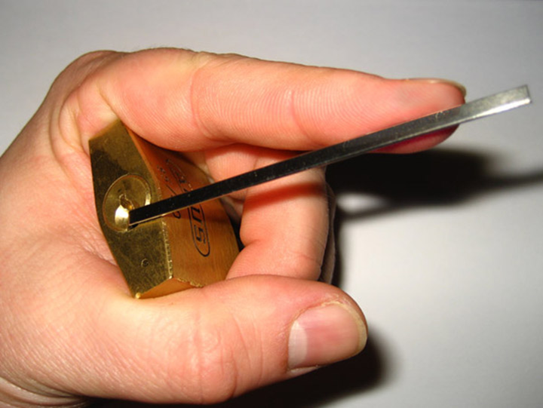
Best Turning Tool Usage (Pushing Out at Tip)

Slide 42
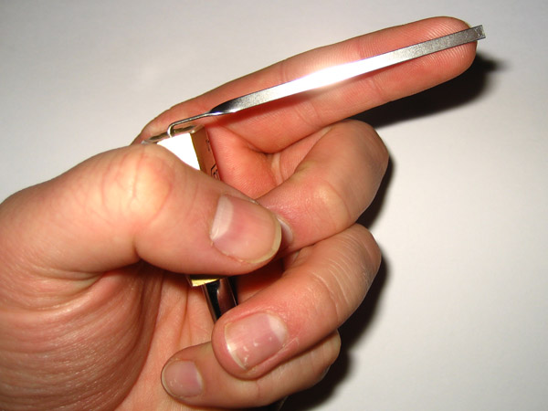
Good Turing Tool Pressure

Slide 43
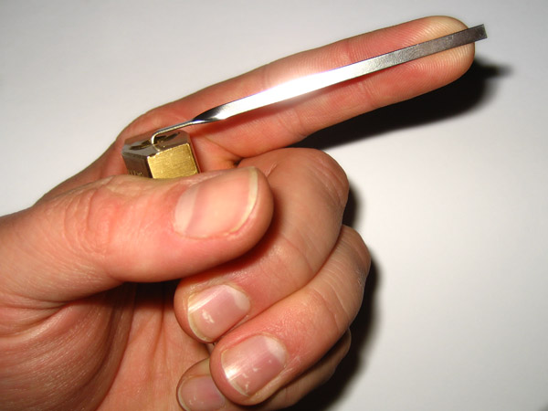
Too Much Turing Tool Pressure!

Slide 44
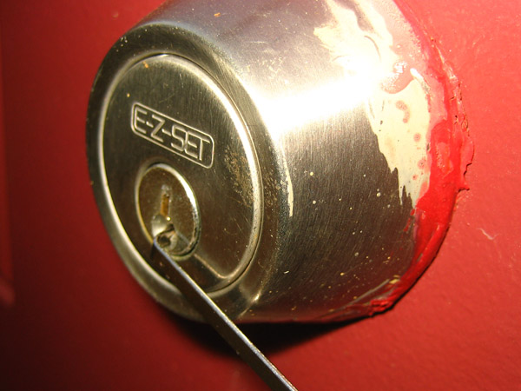
Typical Turning Tool Position: “Edge of the Plug”

Slide 45
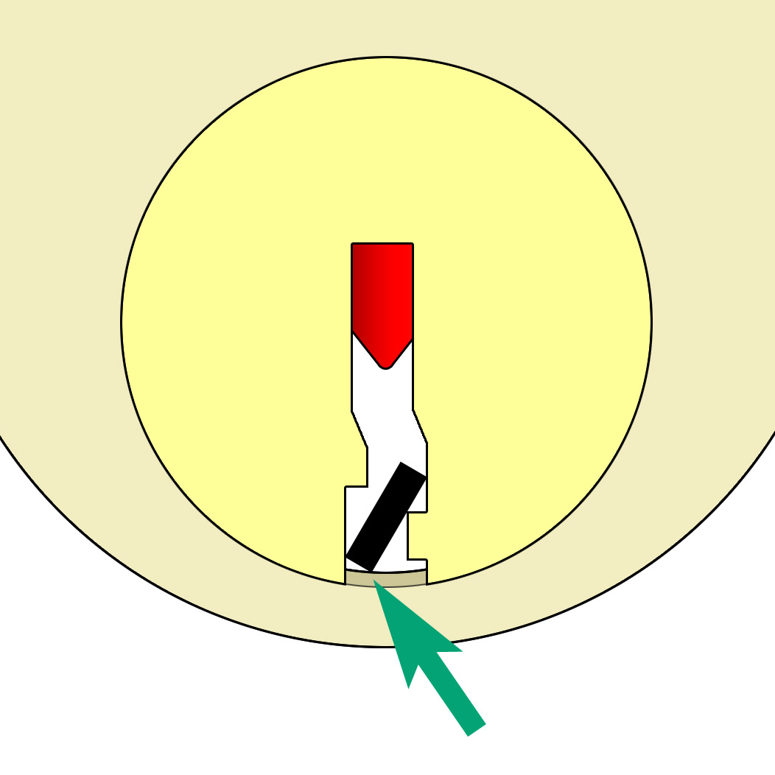
Careful To Not Cause Extra Friction

Slide 46
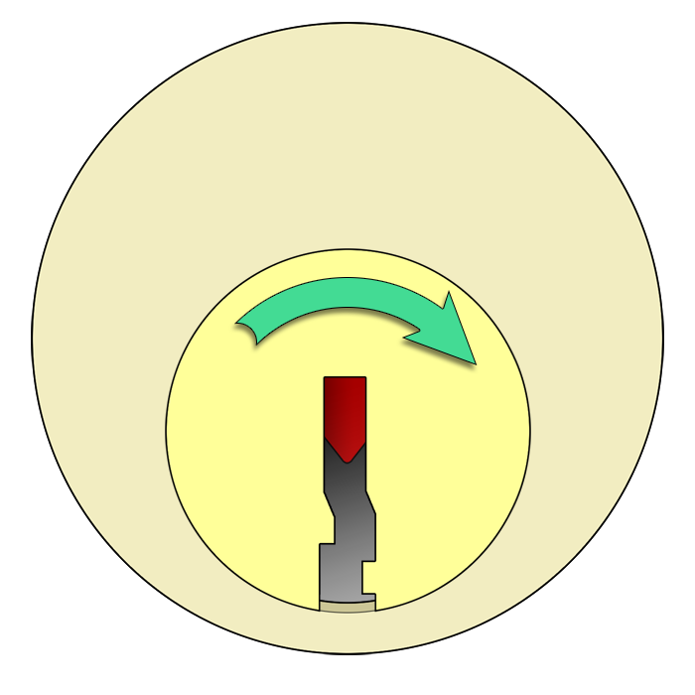
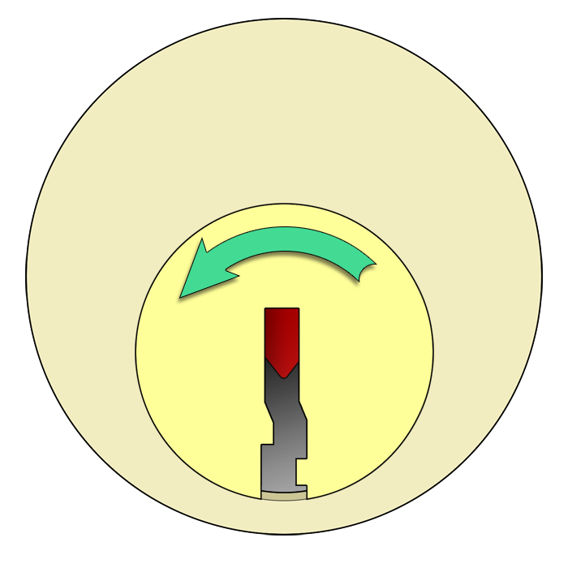

Which Direction Should You Turn?

Slide 47
Which Direction Should You Turn?
☺
Either Direction Will Work On Our Locks

Slide 48
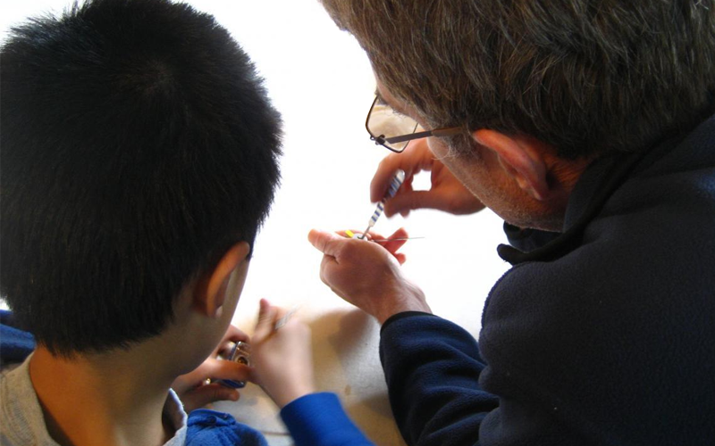
Who Wants To Try?

Slide 49
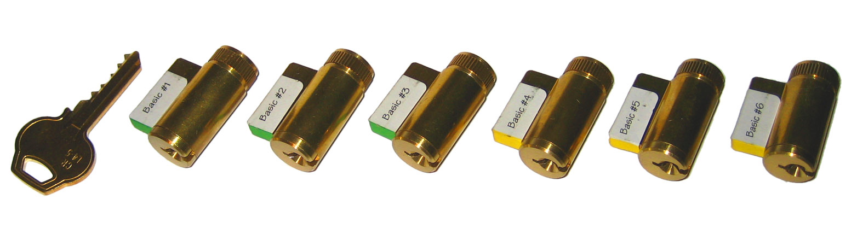

Our Practice Locks

Slide 50
Our Practice Locks
The silver part is the front face…
… the brass ring is the rear!

Slide 51
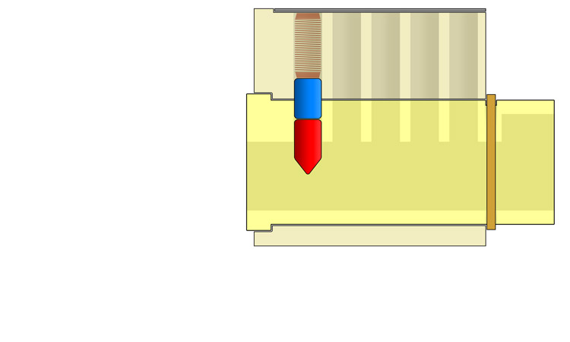
Starter Exercises

Slide 52
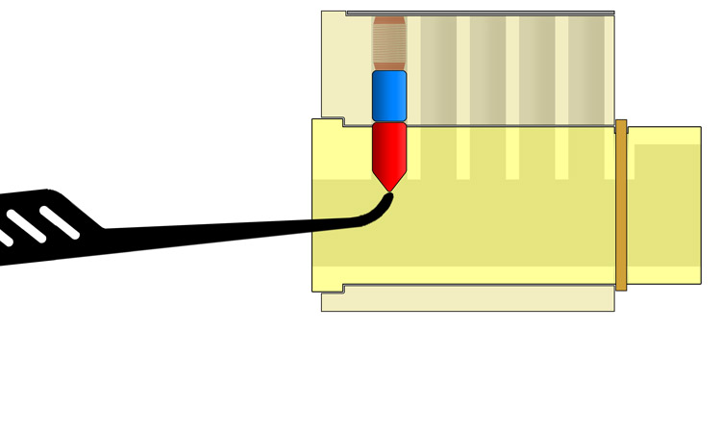
Starter Exercises

Slide 53
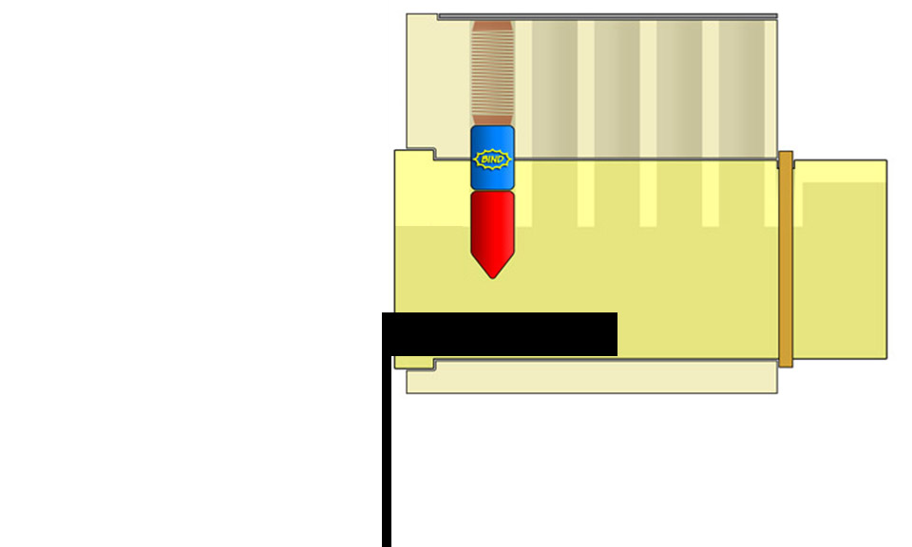
Starter Exercises

Slide 54
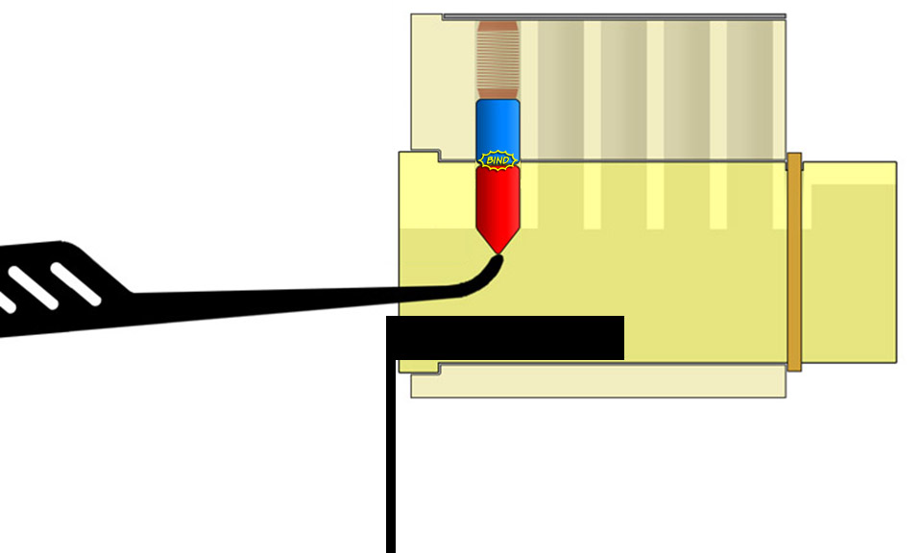
Starter Exercises

Slide 55
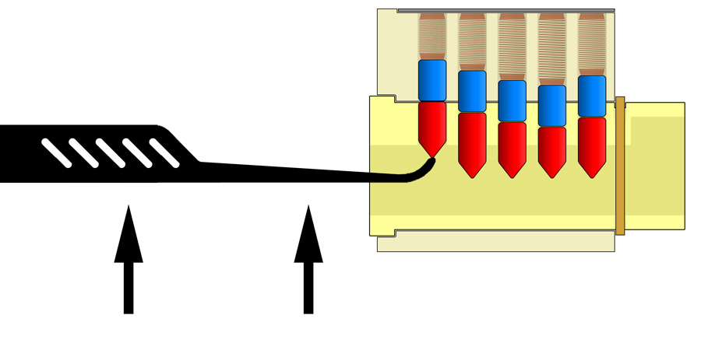
Direct Lifting

Slide 56
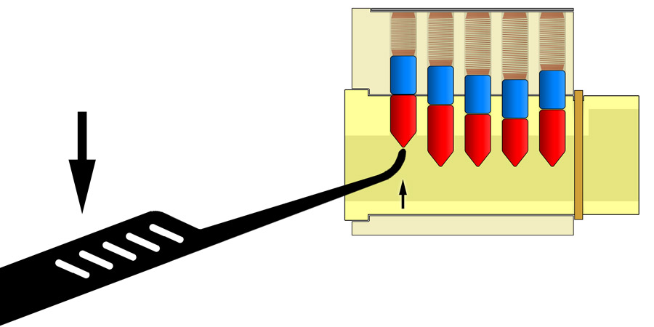
Rocking Lifting

Slide 57
Or Try Raking, Etc.

Slide 58

The Two Most Important Things…
RELAX

Slide 59


The Two Most Important Things…
OPEN!

Slide 60
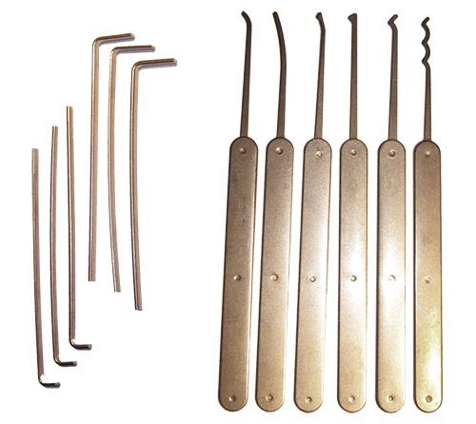

Thank You Very Much!
http://toool.us
info@toool.us
This presentation is CopyLeft by Deviant Ollam. You are free to reuse any or all of this material as long as it is attributed and freedom for other s to do the same is maintained.

Slide 61
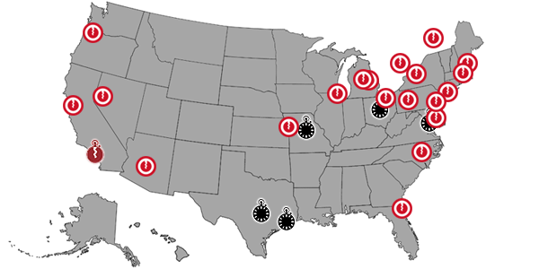
Come Join Us!
This presentation is CopyLeft by Deviant Ollam. You are free to reuse any or all of this material as long as it is attributed and freedom for other s to do the same is maintained.

Slide 62
Thank You Very Much!
http://toool.us
info@toool.us
This presentation is CopyLeft by Deviant Ollam. You are free to reuse any or all of this material as long as it is attributed and freedom for other s to do the same is maintained.

